Slide 1
Chapter 9. Classification: Advanced Methods
Bayesian Belief Networks
Classification by Backpropagation
Support Vector Machines
Classification by Using Frequent Patterns
Lazy Learners (or Learning from Your Neighbors)
Other Classification Methods
Additional Topics Regarding Classification
Summary

Slide 2
Bayesian Belief Networks
Bayesian belief networks (also known as Bayesian networks, probabilistic networks): allow class conditional independencies between subsets of variables
A (directed acyclic) graphical model of causal relationships
  Represents dependency among the variables
  Gives a specification of joint probability distribution
Nodes: random variables
Links: dependency
X and Y are the parents of Z, and Y is the parent of P
No dependency between Z and P
Has no loops/cycles
X
Y
Z
P

Slide 3
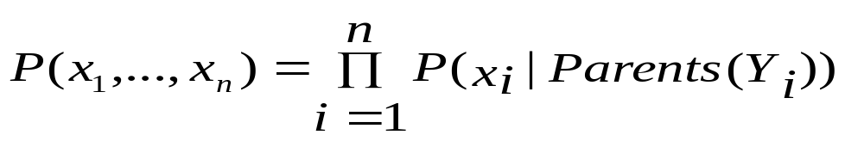
Bayesian Belief Network: An Example
Family
History (FH)
Smoker (S)
CPT: Conditional Probability Table for variable LungCancer:
(FH, S)
(FH, ~S)
(~FH, S)
(~FH, ~S)
LC
0.8
0.5
0.7
0.1
LungCancer
(LC)
Emphysema
~LC
0.2
0.5
0.3
0.9
shows the conditional probability for each possible combination of its parents
PositiveXRay
Dyspnea
Derivation of the probability of a particular combination of values of X, from CPT:
Bayesian Belief Network

Slide 4
Training Bayesian Networks: Several Scenarios
Scenario 1: Given both the network structure and all variables observable: compute only the CPT entries
Scenario 2: Network structure known, some variables hidden: gradient descent (greedy hill-climbing) method, i.e., search for a solution along the steepest descent of a criterion function
  Weights are initialized to random probability values
  At each iteration, it moves towards what appears to be the best solution at the moment, w.o. backtracking
  Weights are updated at each iteration & converge to local optimum
Scenario 3: Network structure unknown, all variables observable: search through the model space to reconstruct network topology
Scenario 4: Unknown structure, all hidden variables: No good algorithms known for this purpose
D. Heckerman. A Tutorial on Learning with Bayesian Networks. In Learning in Graphical Models, M. Jordan, ed.. MIT Press, 1999.

Slide 5
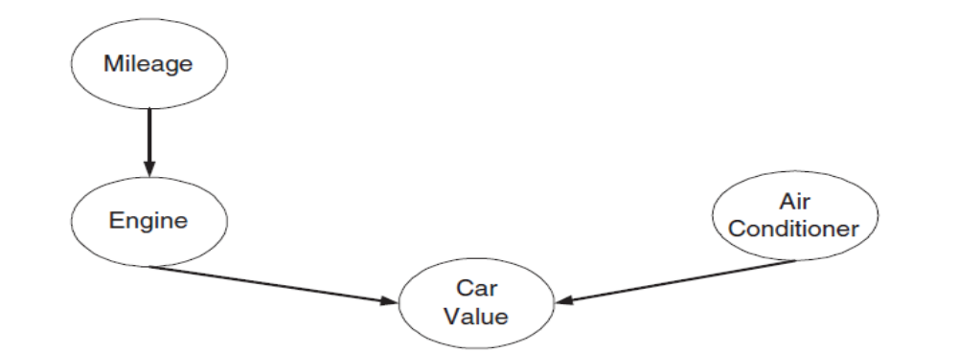
(a) Draw the probability table for each node in the network.
(b) Use the Bayesian network to compute P(Engine = Bad, Air Conditioner= Broken).
Mileage | Engine | Air Conditioner | Number of Records with Car Value=Hi | Number of Records with Car Value=Lo
Hi | Good | Working | 3 | 4
Hi | Good | Broken | 1 | 2
Hi | Bad | Working | 1 | 5
Hi | Bad | Broken | 0 | 4
Lo | Good | Working | 10 | 0
Lo | Good | Broken | 3 | 1
Lo | Bad | Working | 2 | 2
Lo | Bad | Broken | 0 | 2

Slide 6
Mileage | Engine | Air Conditioner | Number of Records with Car Value=Hi | Number of Records with Car Value=Lo
Hi | Good | Working | 3 | 4
Hi | Good | Broken | 1 | 2
Hi | Bad | Working | 1 | 5
Hi | Bad | Broken | 0 | 4
Lo | Good | Working | 10 | 0
Lo | Good | Broken | 3 | 1
Lo | Bad | Working | 2 | 2
Lo | Bad | Broken | 0 | 2
P(C=Hi|E=G,A=W))=13/17
P(C=Lo|E=G,A=W))=4/17
P(C=Hi|E=G,A=B)=4/7
P(C=Lo|E=G,A=B)=3/7
P(C=Hi|E=B,A=W)=0.3
P(C=Lo|E=B,A=W)=0.7
P(C=Hi|E=B,A=B)=0
P(C=Lo|E=B,A=B)=1
P(M=Hi)= 0.5
P(M=Lo)= 0.5
P(A=W)= 27/40
P(A=B)= 13/40
P(E=G|M=Hi)= 0.5
P(E=B|M=Hi)=0.5
P(E=G|M=Lo)= 0.7
P(E=B|M=Lo)= 0.3
Notes:
P(M=Hi)= 20/40=0.5
P(A=W)= (3+4+1+5+10+0+2+2)/40=27/40
P(A=B)= (1+2+0+4+3+1+0+2)/40=13/40
P(E=G|M=Hi)= (3+1+4+2)/(3+1+1+4+2+5+4)=10/20=0.5
P(E=B|M=Hi)= (1+5+4)/(3+1+1+4+2+5+4)=10/20=0.5
P(E=G|M=Lo)= (10+3+0+1)/(10+3+2+1+2+2)=14/20=0.7
P(E=B|M=Lo)= (2+2+2)/(10+3+2+1+2+2)=6/20=0.3
P(C=Hi|E=G,A=W))=(3+10)/(3+4+10)=13/17
P(C=Lo|E=G,A=W))=(4)/(3+4+10)=13/17
P(C=Hi|E=G,A=B)=(1+3)/(1+2+3+1)=4/7
P(C=Lo|E=G,A=B)=(2+1)/(1+2+3+1)=3/7
P(C=Hi|E=B,A=W)=(1+2)/(1+5+2+2)=3/10=0.3
P(C=Lo|E=B,A=W)=(5+2)/(1+5+2+2)=0.7
P(C=Hi|E=B,A=B)=0/(4+2)=0
P(C=Lo|E=B,A=B) =(4+2)/(4+2)=1

Slide 7
Chapter 9. Classification: Advanced Methods
Bayesian Belief Networks
Classification by Backpropagation
Support Vector Machines
Classification by Using Frequent Patterns
Lazy Learners (or Learning from Your Neighbors)
Other Classification Methods
Additional Topics Regarding Classification
Summary

Slide 8
Classification by Backpropagation
Backpropagation: A neural network learning algorithm
Started by psychologists and neurobiologists to develop and test computational analogues of neurons
A neural network: A set of connected input/output units where each connection has a weight associated with it
During the learning phase, the network learns by adjusting the weights so as to be able to predict the correct class label of the input tuples
Also referred to as connectionist learning due to the connections between units

Slide 9
Neural Network as a Classifier
Weakness
  Long training time
  Require a number of parameters typically best determined empirically, e.g., the network topology or “structure.”
  Poor interpretability: Difficult to interpret the symbolic meaning behind the learned weights and of “hidden units” in the network
Strength
  High tolerance to noisy data
  Ability to classify untrained patterns
  Well-suited for continuous-valued inputs and outputs
  Successful on an array of real-world data, e.g., hand-written letters
  Algorithms are inherently parallel
  Techniques have recently been developed for the extraction of rules from trained neural networks

Slide 10
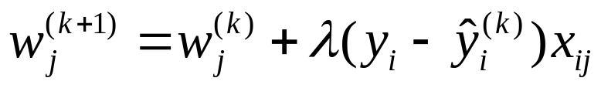
A Multi-Layer Feed-Forward Neural Network
Output vector
Output layer
Hidden layer
w_{ij}
Input layer
Input vector: X
Notes:
MK: Note – different notation than used in book. Will have to standardize notation.

Slide 11
How A Multi-Layer Neural Network Works
The inputs to the network correspond to the attributes measured for each training tuple
Inputs are fed simultaneously into the units making up the input layer
They are then weighted and fed simultaneously to a hidden layer
The number of hidden layers is arbitrary, although usually only one
The weighted outputs of the last hidden layer are input to units making up the output layer, which emits the network's prediction
The network is feed-forward: None of the weights cycles back to an input unit or to an output unit of a previous layer
From a statistical point of view, networks perform nonlinear regression: Given enough hidden units and enough training samples, they can closely approximate any function

Slide 12
Defining a Network Topology
Decide the network topology: Specify # of units in the input layer, # of hidden layers (if > 1), # of units in each hidden layer, and # of units in the output layer
Normalize the input values for each attribute measured in the training tuples to [0.0—1.0]
One input unit per domain value, each initialized to 0
Output, if for classification and more than two classes, one output unit per class is used
Once a network has been trained and its accuracy is unacceptable, repeat the training process with a different network topology or a different set of initial weights

Slide 13
Backpropagation
Iteratively process a set of training tuples & compare the network's prediction with the actual known target value
For each training tuple, the weights are modified to minimize the mean squared error between the network's prediction and the actual target value
Modifications are made in the “backwards” direction: from the output layer, through each hidden layer down to the first hidden layer, hence “backpropagation”
Steps
  Initialize weights to small random numbers, associated with biases
  Propagate the inputs forward (by applying activation function)
  Backpropagate the error (by updating weights and biases)
  Terminating condition (when error is very small, etc.)

Slide 14
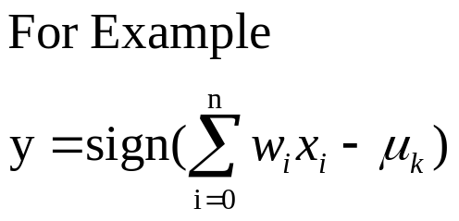
Neuron: A Hidden/Output Layer Unit
bias
μ_{k}
x₀
w₀
x₁
w₁
∑
f
output y
x_{n}
w_{n}
Input
vector x
weight
vector w
weighted
sum
Activation
function
An n-dimensional input vector x is mapped into variable y by means of the scalar product and a nonlinear function mapping
The inputs to unit are outputs from the previous layer. They are multiplied by their corresponding weights to form a weighted sum, which is added to the bias associated with unit. Then a nonlinear activation function is applied to it.

Slide 15
Efficiency and Interpretability
Efficiency of backpropagation: Each epoch (one iteration through the training set) takes O(|D| * w), with |D| tuples and w weights, but # of epochs can be exponential to n, the number of inputs, in worst case
For easier comprehension: Rule extraction by network pruning
  Simplify the network structure by removing weighted links that have the least effect on the trained network
  Then perform link, unit, or activation value clustering
  The set of input and activation values are studied to derive rules describing the relationship between the input and hidden unit layers
Sensitivity analysis: assess the impact that a given input variable has on a network output. The knowledge gained from this analysis can be represented in rules

Slide 16
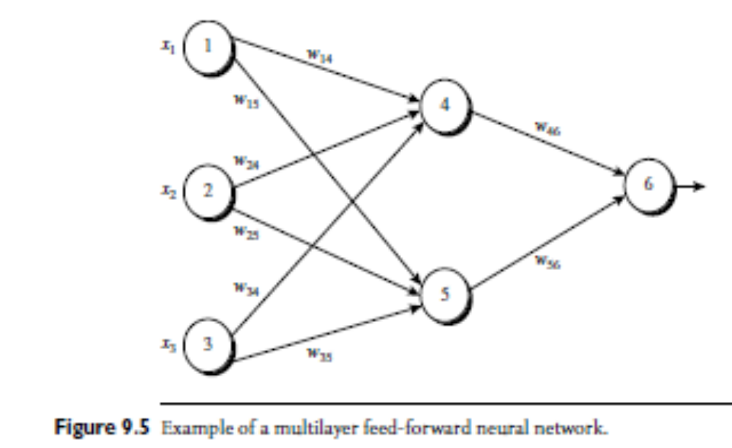
Data Mining: Concepts and Techniques

Slide 17
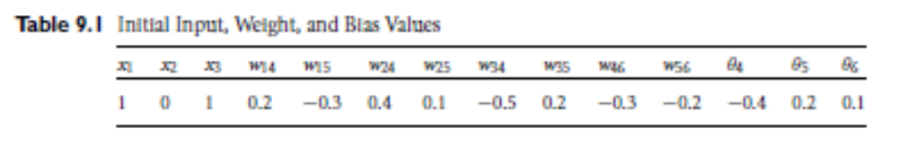
Data Mining: Concepts and Techniques

Slide 18
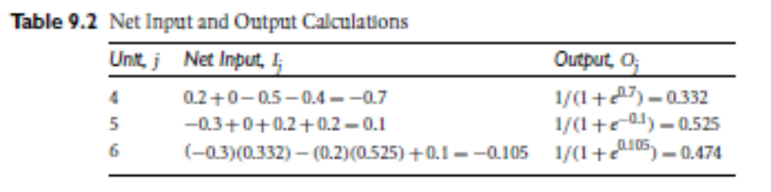
Data Mining: Concepts and Techniques

Slide 19
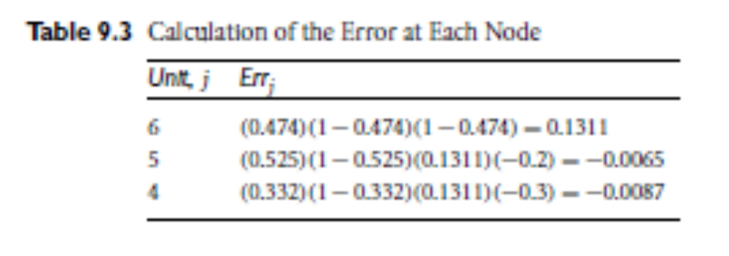
Data Mining: Concepts and Techniques

Slide 20
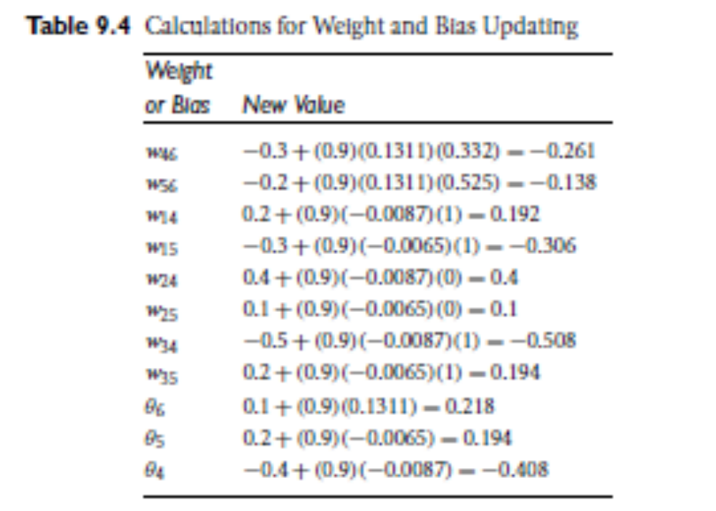
Data Mining: Concepts and Techniques

Slide 21
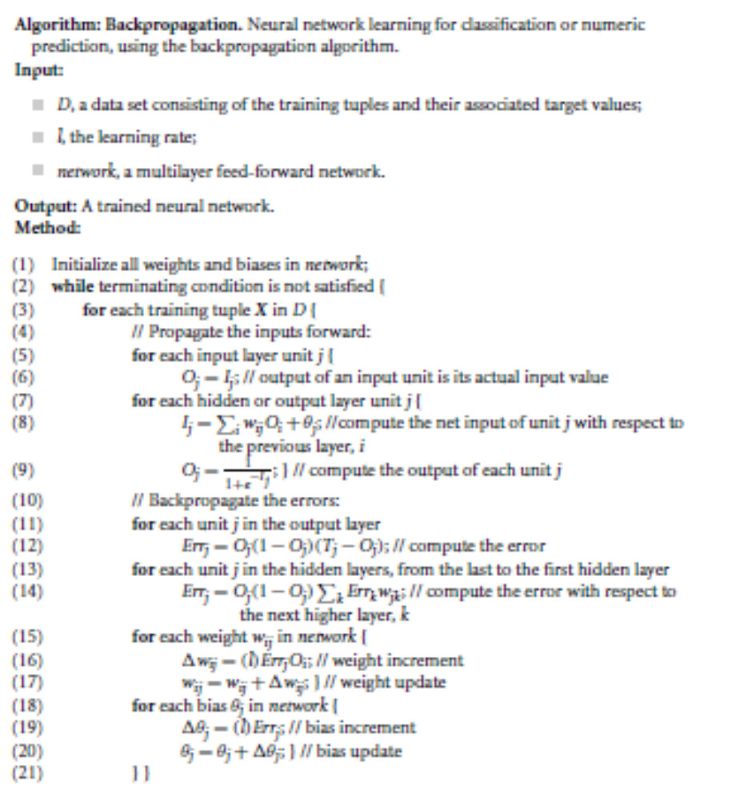
Data Mining: Concepts and Techniques

Slide 22
Chapter 9. Classification: Advanced Methods
Bayesian Belief Networks
Classification by Backpropagation
Support Vector Machines
Classification by Using Frequent Patterns
Lazy Learners (or Learning from Your Neighbors)
Other Classification Methods
Additional Topics Regarding Classification
Summary

Slide 23
Classification: A Mathematical Mapping
Classification: predicts categorical class labels
  E.g., Personal homepage classification
    x_{i} = (x₁, x₂, x₃, …), y_{i} = +1 or –1
    x₁ : # of word “homepage”
    x₂ : # of word “welcome”
Mathematically, x ∈ X = ℜ^{n}, y ∈ Y = {+1, –1},
  We want to derive a function f: X → Y
Linear Classification
  Binary Classification problem
  Data above the red line belongs to class ‘x’
  Data below red line belongs to class ‘o’
  Examples: SVM, Perceptron, Probabilistic Classifiers
x
x
x
x
x
x
x
x
x
o
o
x
o
o
o
o
o
o
o
o
o
o
o

Slide 24
Discriminative Classifiers
Advantages
  Prediction accuracy is generally high
    As compared to Bayesian methods – in general
  Robust, works when training examples contain errors
  Fast evaluation of the learned target function
    Bayesian networks are normally slow
Criticism
  Long training time
  Difficult to understand the learned function (weights)
    Bayesian networks can be used easily for pattern discovery
  Not easy to incorporate domain knowledge
    Easy in the form of priors on the data or distributions

Slide 25
SVM—Support Vector Machines
A relatively new classification method for both linear and nonlinear data
It uses a nonlinear mapping to transform the original training data into a higher dimension
With the new dimension, it searches for the linear optimal separating hyperplane (i.e., “decision boundary”)
With an appropriate nonlinear mapping to a sufficiently high dimension, data from two classes can always be separated by a hyperplane
SVM finds this hyperplane using support vectors (“essential” training tuples) and margins (defined by the support vectors)

Slide 26
SVM—History and Applications
Vapnik and colleagues (1992)—groundwork from Vapnik & Chervonenkis’ statistical learning theory in 1960s
Features: training can be slow but accuracy is high owing to their ability to model complex nonlinear decision boundaries (margin maximization)
Used for: classification and numeric prediction
Applications:
  handwritten digit recognition, object recognition, speaker identification, benchmarking time-series prediction tests

Slide 27
SVM—General Philosophy
Small Margin
Large Margin
Support Vectors

Slide 28


SVM—Margins and Support Vectors
Data Mining: Concepts and Techniques

Slide 29
SVM—When Data Is Linearly Separable
m
Let data D be (X₁, y₁), …, (X_{|D|}, y_{|D|}), where X_{i} is the set of training tuples associated with the class labels y_{i}
There are infinite lines (hyperplanes) separating the two classes but we want to find the best one (the one that minimizes classification error on unseen data)
SVM searches for the hyperplane with the largest margin, i.e., maximum marginal hyperplane (MMH)

Slide 30
SVM—Linearly Separable
A separating hyperplane can be written as
    W ● X + b = 0
  where W={w₁, w₂, …, w_{n}} is a weight vector and b a scalar (bias)
For 2-D it can be written as
    w₀ + w₁ x₁ + w₂ x₂ = 0
The hyperplane defining the sides of the margin:
    H₁: w₀ + w₁ x₁ + w₂ x₂ ≥ 1 for y_{i} = +1, and
    H₂: w₀ + w₁ x₁ + w₂ x₂ ≤ – 1 for y_{i} = –1
Any training tuples that fall on hyperplanes H₁ or H₂ (i.e., the
sides defining the margin) are support vectors
This becomes a constrained (convex) quadratic optimization problem: Quadratic objective function and linear constraints → Quadratic Programming (QP) → Lagrangian multipliers

Slide 31
Why Is SVM Effective on High Dimensional Data?
The complexity of trained classifier is characterized by the # of support vectors rather than the dimensionality of the data
The support vectors are the essential or critical training examples —they lie closest to the decision boundary (MMH)
If all other training examples are removed and the training is repeated, the same separating hyperplane would be found
The number of support vectors found can be used to compute an (upper) bound on the expected error rate of the SVM classifier, which is independent of the data dimensionality
Thus, an SVM with a small number of support vectors can have good generalization, even when the dimensionality of the data is high

Slide 32


SVM—Linearly Inseparable
Transform the original input data into a higher dimensional space
Search for a linear separating hyperplane in the new space

Slide 33
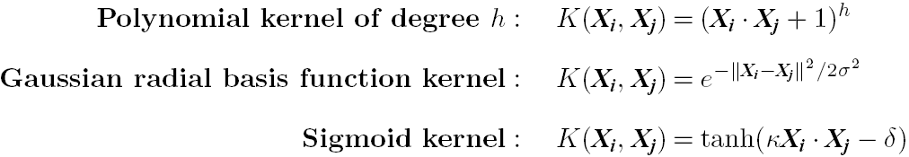
SVM: Different Kernel functions
Instead of computing the dot product on the transformed data, it is math. equivalent to applying a kernel function K(X_{i}, X_{j}) to the original data, i.e., K(X_{i}, X_{j}) = Φ(X_{i}) Φ(X_{j})
Typical Kernel Functions
SVM can also be used for classifying multiple (> 2) classes and for regression analysis (with additional parameters)

Slide 34
Scaling SVM by Hierarchical Micro-Clustering
SVM is not scalable to the number of data objects in terms of training time and memory usage
H. Yu, J. Yang, and J. Han, “Classifying Large Data Sets Using SVM with Hierarchical Clusters”, KDD'03)
CB-SVM (Clustering-Based SVM)
  Given limited amount of system resources (e.g., memory), maximize the SVM performance in terms of accuracy and the training speed
  Use micro-clustering to effectively reduce the number of points to be considered
  At deriving support vectors, de-cluster micro-clusters near “candidate vector” to ensure high classification accuracy

Slide 35
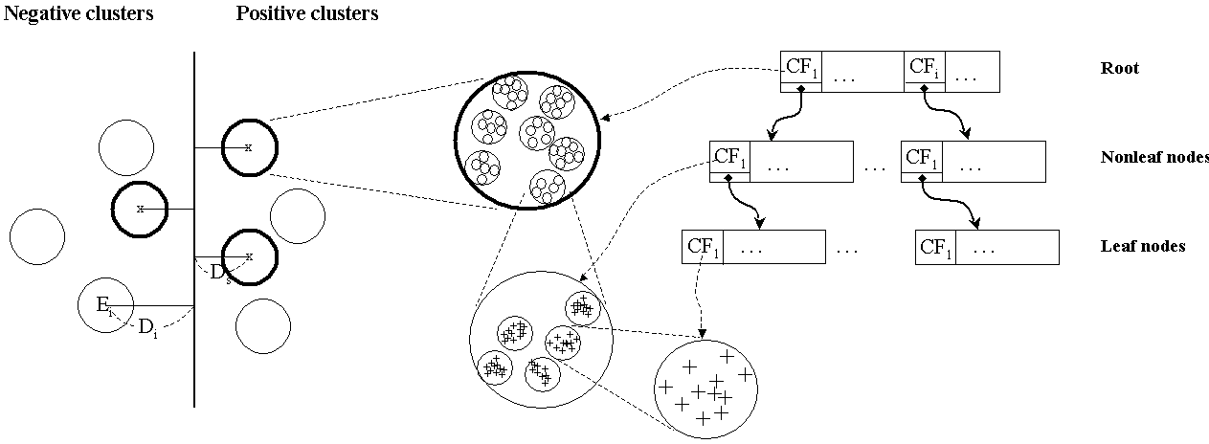
CF-Tree: Hierarchical Micro-cluster
Read the data set once, construct a statistical summary of the data (i.e., hierarchical clusters) given a limited amount of memory
Micro-clustering: Hierarchical indexing structure
  provide finer samples closer to the boundary and coarser samples farther from the boundary

Slide 36
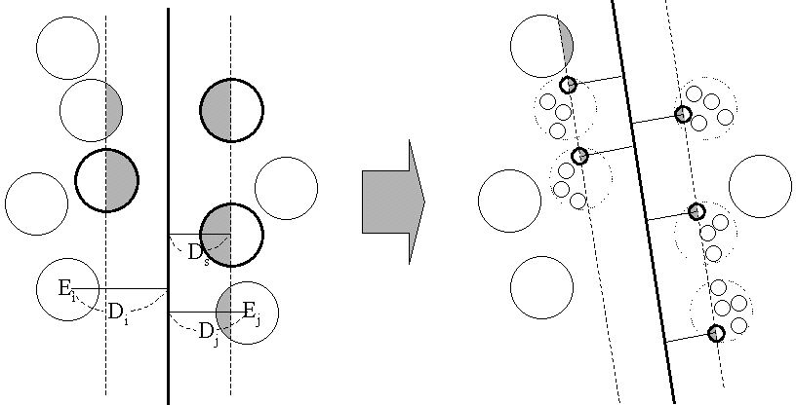
Selective Declustering: Ensure High Accuracy
CF tree is a suitable base structure for selective declustering
De-cluster only the cluster E_{i} such that
  D_{i} – R_{i} < D_{s}, where D_{i} is the distance from the boundary to the center point of E_{i} and R_{i} is the radius of E_{i}
  Decluster only the cluster whose subclusters have possibilities to be the support cluster of the boundary
    “Support cluster”: The cluster whose centroid is a support vector

Slide 37
CB-SVM Algorithm: Outline
Construct two CF-trees from positive and negative data sets independently
  Need one scan of the data set
Train an SVM from the centroids of the root entries
De-cluster the entries near the boundary into the next level
  The children entries de-clustered from the parent entries are accumulated into the training set with the non-declustered parent entries
Train an SVM again from the centroids of the entries in the training set
Repeat until nothing is accumulated

Slide 38
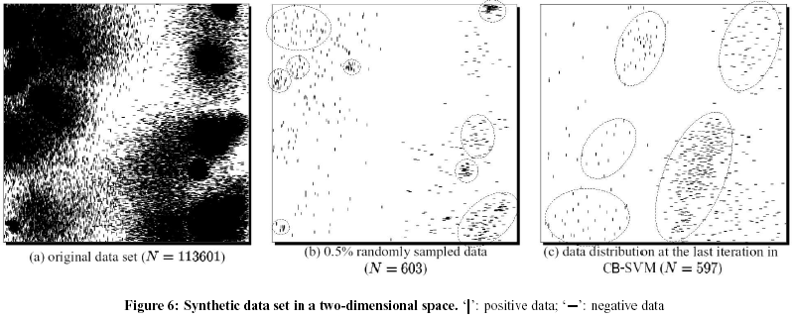
Accuracy and Scalability on Synthetic Dataset
Experiments on large synthetic data sets shows better accuracy than random sampling approaches and far more scalable than the original SVM algorithm

Slide 39
SVM vs. Neural Network
SVM
  Deterministic algorithm
  Nice generalization properties
  Hard to learn – learned in batch mode using quadratic programming techniques
  Using kernels can learn very complex functions
Neural Network
  Nondeterministic algorithm
  Generalizes well but doesn’t have strong mathematical foundation
  Can easily be learned in incremental fashion
  To learn complex functions—use multilayer perceptron (nontrivial)

Slide 40
SVM Related Links
SVM Website: http://www.kernel-machines.org/
Representative implementations
  LIBSVM: an efficient implementation of SVM, multi-class classifications, nu-SVM, one-class SVM, including also various interfaces with java, python, etc.
  SVM-light: simpler but performance is not better than LIBSVM, support only binary classification and only in C
  SVM-torch: another recent implementation also written in C

Slide 41
Chapter 9. Classification: Advanced Methods
Bayesian Belief Networks
Classification by Backpropagation
Support Vector Machines
Classification by Using Frequent Patterns
Lazy Learners (or Learning from Your Neighbors)
Other Classification Methods
Additional Topics Regarding Classification
Summary

Slide 42
Associative Classification
Associative classification: Major steps
  Mine data to find strong associations between frequent patterns (conjunctions of attribute-value pairs) and class labels
  Association rules are generated in the form of
      P₁ ^ p₂ … ^ p_{l} → “A_{class} = C” (conf, sup)
  Organize the rules to form a rule-based classifier
Why effective?
  It explores highly confident associations among multiple attributes and may overcome some constraints introduced by decision-tree induction, which considers only one attribute at a time
  Associative classification has been found to be often more accurate than some traditional classification methods, such as C4.5

Slide 43
Typical Associative Classification Methods
CBA (Classification Based on Associations: Liu, Hsu & Ma, KDD’98)
  Mine possible association rules in the form of
    Cond-set (a set of attribute-value pairs) → class label
  Build classifier: Organize rules according to decreasing precedence based on confidence and then support
CMAR (Classification based on Multiple Association Rules: Li, Han, Pei, ICDM’01)
  Classification: Statistical analysis on multiple rules
CPAR (Classification based on Predictive Association Rules: Yin & Han, SDM’03)
  Generation of predictive rules (FOIL-like analysis) but allow covered rules to retain with reduced weight
  Prediction using best k rules
  High efficiency, accuracy similar to CMAR

Slide 44
Frequent Pattern-Based Classification
H. Cheng, X. Yan, J. Han, and C.-W. Hsu, “Discriminative Frequent Pattern Analysis for Effective Classification”, ICDE'07
Accuracy issue
  Increase the discriminative power
  Increase the expressive power of the feature space
Scalability issue
  It is computationally infeasible to generate all feature combinations and filter them with an information gain threshold
  Efficient method (DDPMine: FPtree pruning): H. Cheng, X. Yan, J. Han, and P. S. Yu, "Direct Discriminative Pattern Mining for Effective Classification", ICDE'08

Slide 45
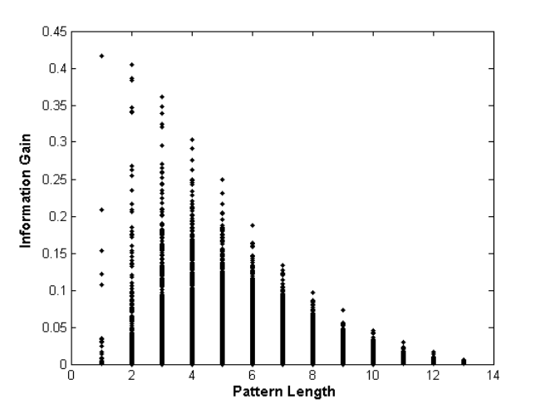
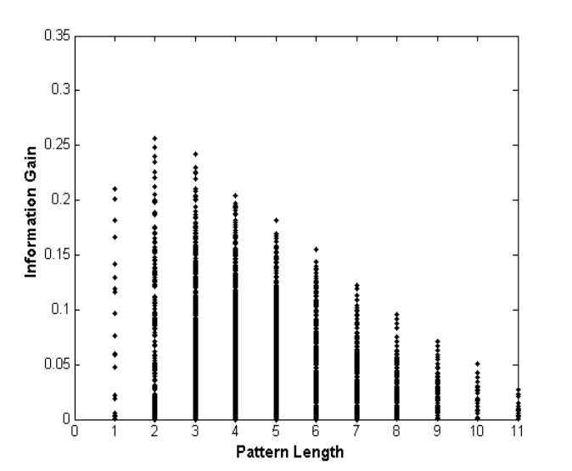
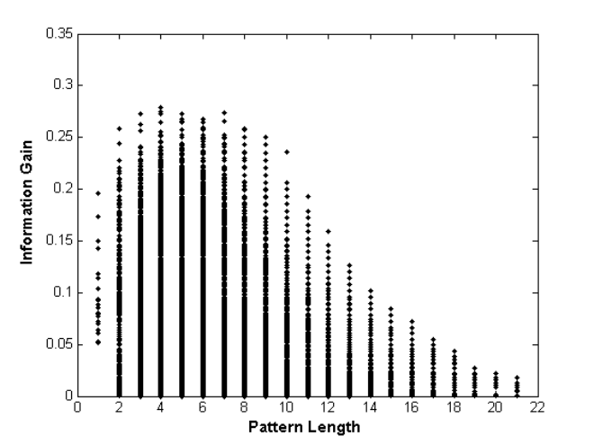
Frequent Pattern vs. Single Feature
  The discriminative power of some frequent patterns is higher than that of single features.
(a) Austral
(b) Cleve
(c) Sonar
Fig. 1. Information Gain vs. Pattern Length

Slide 46
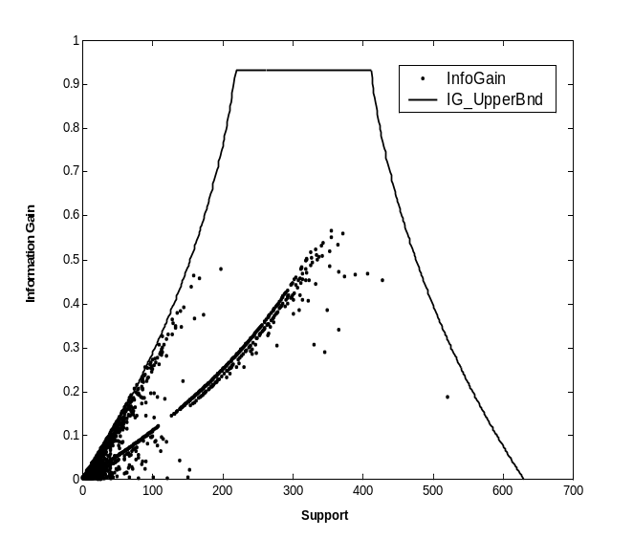
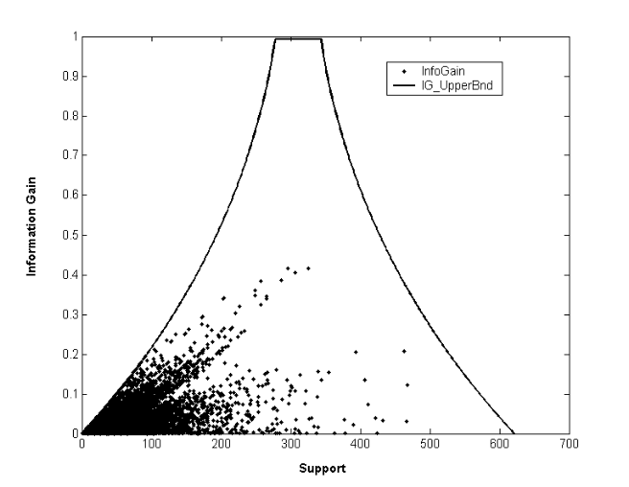
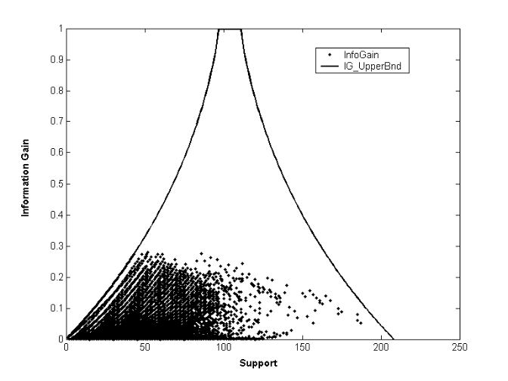
Empirical Results
(a) Austral
(b) Breast
(c) Sonar
Fig. 2. Information Gain vs. Pattern Frequency

Slide 47
Feature Selection
Given a set of frequent patterns, both non-discriminative and redundant patterns exist, which can cause overfitting
We want to single out the discriminative patterns and remove redundant ones
The notion of Maximal Marginal Relevance (MMR) is borrowed
  A document has high marginal relevance if it is both relevant to the query and contains minimal marginal similarity to previously selected documents

Slide 48
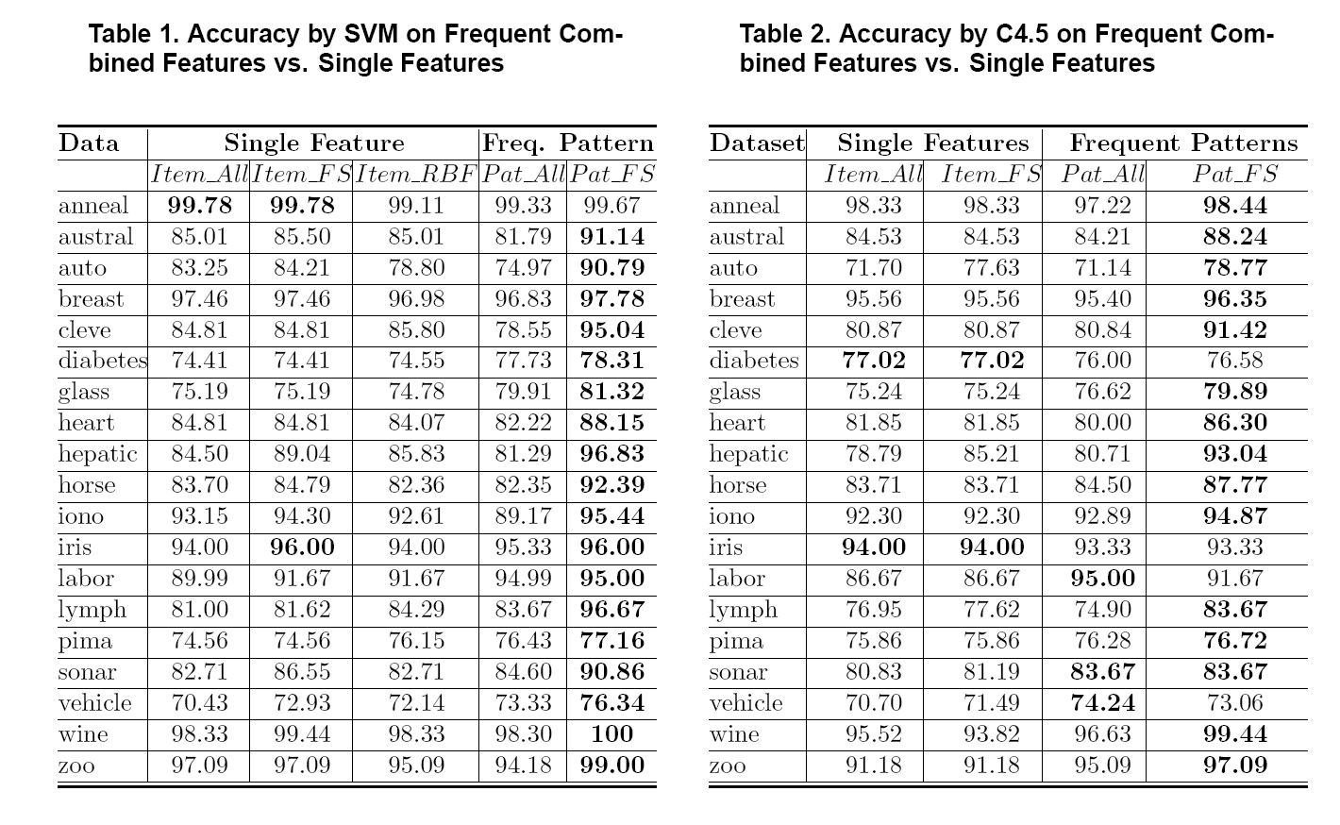
Experimental Results

Slide 49
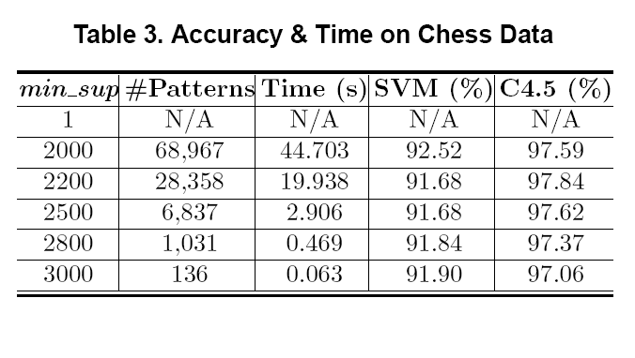
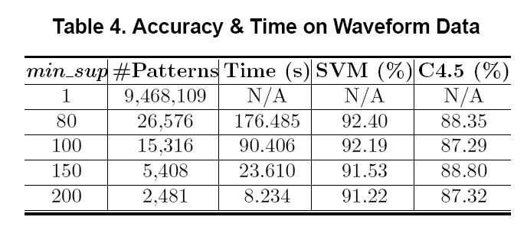
Scalability Tests

Slide 50


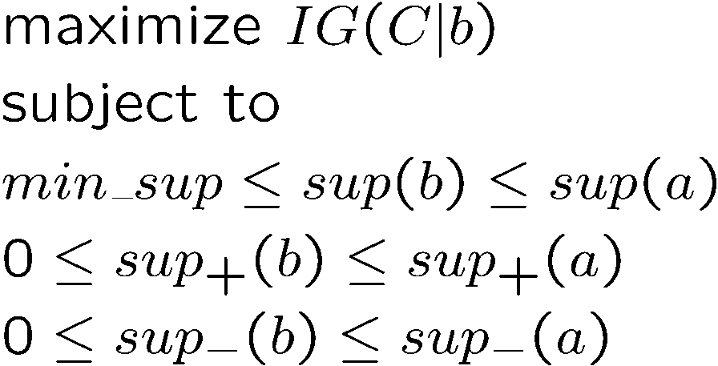
DDPMine: Branch-and-Bound Search
a
b
a: constant, a parent node
b: variable, a descendent
Association between information gain and frequency
Notes:
Explore the bound in mining

Slide 51
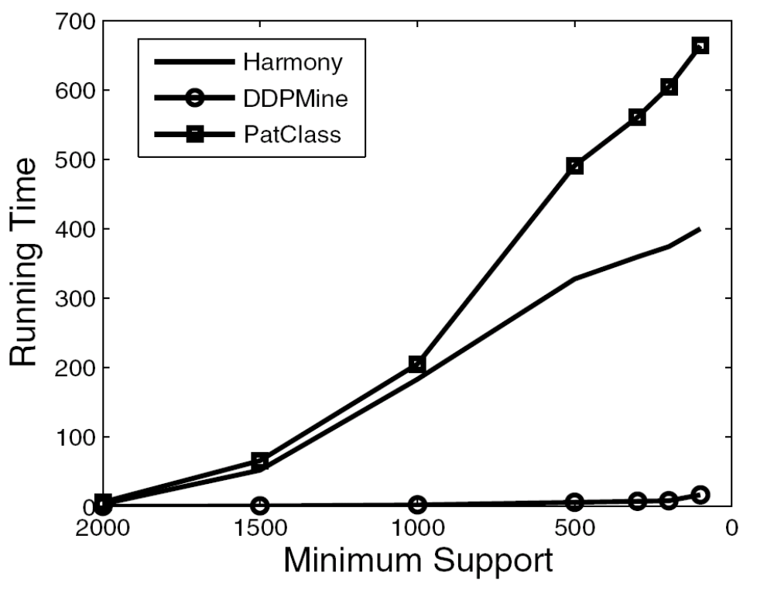
DDPMine Efficiency: Runtime
PatClass
Harmony
PatClass: ICDE’07 Pattern Classification Alg.
DDPMine
Notes:
One fig

Slide 52
Chapter 9. Classification: Advanced Methods
Bayesian Belief Networks
Classification by Backpropagation
Support Vector Machines
Classification by Using Frequent Patterns
Lazy Learners (or Learning from Your Neighbors)
Other Classification Methods
Additional Topics Regarding Classification
Summary

Slide 53
Lazy vs. Eager Learning
Lazy vs. eager learning
  Lazy learning (e.g., instance-based learning): Simply stores training data (or only minor processing) and waits until it is given a test tuple
  Eager learning (the above discussed methods): Given a set of training tuples, constructs a classification model before receiving new (e.g., test) data to classify
Lazy: less time in training but more time in predicting
Accuracy
  Lazy method effectively uses a richer hypothesis space since it uses many local linear functions to form an implicit global approximation to the target function
  Eager: must commit to a single hypothesis that covers the entire instance space

Slide 54
Lazy Learner: Instance-Based Methods
Instance-based learning:
  Store training examples and delay the processing (“lazy evaluation”) until a new instance must be classified
Typical approaches
  k-nearest neighbor approach
    Instances represented as points in a Euclidean space.
  Locally weighted regression
    Constructs local approximation
  Case-based reasoning
    Uses symbolic representations and knowledge-based inference

Slide 55
The k-Nearest Neighbor Algorithm
All instances correspond to points in the n-D space
The nearest neighbor are defined in terms of Euclidean distance, dist(X₁, X₂)
Target function could be discrete- or real- valued
For discrete-valued, k-NN returns the most common value among the k training examples nearest to x_{q}
Vonoroi diagram: the decision surface induced by 1-NN for a typical set of training examples
_
.
.
_
_
+
_
.
.
+
.
_
x_{q}
+
_
.
+

Slide 56
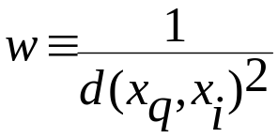
Discussion on the k-NN Algorithm
k-NN for real-valued prediction for a given unknown tuple
  Returns the mean values of the k nearest neighbors
Distance-weighted nearest neighbor algorithm
  Weight the contribution of each of the k neighbors according to their distance to the query x_{q}
    Give greater weight to closer neighbors
Robust to noisy data by averaging k-nearest neighbors
Curse of dimensionality: distance between neighbors could be dominated by irrelevant attributes
  To overcome it, axes stretch or elimination of the least relevant attributes

Slide 57
Case-Based Reasoning (CBR)
CBR: Uses a database of problem solutions to solve new problems
Store symbolic description (tuples or cases)—not points in a Euclidean space
Applications: Customer-service (product-related diagnosis), legal ruling
Methodology
  Instances represented by rich symbolic descriptions (e.g., function graphs)
  Search for similar cases, multiple retrieved cases may be combined
  Tight coupling between case retrieval, knowledge-based reasoning, and problem solving
Challenges
  Find a good similarity metric
  Indexing based on syntactic similarity measure, and when failure, backtracking, and adapting to additional cases

Slide 58
Chapter 9. Classification: Advanced Methods
Bayesian Belief Networks
Classification by Backpropagation
Support Vector Machines
Classification by Using Frequent Patterns
Lazy Learners (or Learning from Your Neighbors)
Other Classification Methods
Additional Topics Regarding Classification
Summary

Slide 59
Genetic Algorithms (GA)
Genetic Algorithm: based on an analogy to biological evolution
An initial population is created consisting of randomly generated rules
  Each rule is represented by a string of bits
  E.g., if A₁ and ¬A₂ then C₂ can be encoded as 100
  If an attribute has k > 2 values, k bits can be used
Based on the notion of survival of the fittest, a new population is formed to consist of the fittest rules and their offspring
The fitness of a rule is represented by its classification accuracy on a set of training examples
Offspring are generated by crossover and mutation
The process continues until a population P evolves when each rule in P satisfies a prespecified threshold
Slow but easily parallelizable

Slide 60

Rough Set Approach
Rough sets are used to approximately or “roughly” define equivalent classes
A rough set for a given class C is approximated by two sets: a lower approximation (certain to be in C) and an upper approximation (cannot be described as not belonging to C)
Finding the minimal subsets (reducts) of attributes for feature reduction is NP-hard but a discernibility matrix (which stores the differences between attribute values for each pair of data tuples) is used to reduce the computation intensity

Slide 61

Fuzzy Set Approaches
Fuzzy logic uses truth values between 0.0 and 1.0 to represent the degree of membership (such as in a fuzzy membership graph)
Attribute values are converted to fuzzy values. Ex.:
  Income, x, is assigned a fuzzy membership value to each of the discrete categories {low, medium, high}, e.g. $49K belongs to “medium income” with fuzzy value 0.15 but belongs to “high income” with fuzzy value 0.96
  Fuzzy membership values do not have to sum to 1.
Each applicable rule contributes a vote for membership in the categories
Typically, the truth values for each predicted category are summed, and these sums are combined

Slide 62
Chapter 9. Classification: Advanced Methods
Bayesian Belief Networks
Classification by Backpropagation
Support Vector Machines
Classification by Using Frequent Patterns
Lazy Learners (or Learning from Your Neighbors)
Other Classification Methods
Additional Topics Regarding Classification
Summary

Slide 63
Multiclass Classification
Classification involving more than two classes (i.e., > 2 Classes)
Method 1. One-vs.-all (OVA): Learn a classifier one at a time
  Given m classes, train m classifiers: one for each class
  Classifier j: treat tuples in class j as positive & all others as negative
  To classify a tuple X, the set of classifiers vote as an ensemble
Method 2. All-vs.-all (AVA): Learn a classifier for each pair of classes
  Given m classes, construct m(m-1)/2 binary classifiers
  A classifier is trained using tuples of the two classes
  To classify a tuple X, each classifier votes. X is assigned to the class with maximal vote
Comparison
  All-vs.-all tends to be superior to one-vs.-all
  Problem: Binary classifier is sensitive to errors, and errors affect vote count

Slide 64
Error-Correcting Codes for Multiclass Classification
Originally designed to correct errors during data transmission for communication tasks by exploring data redundancy
Example
  A 7-bit codeword associated with classes 1-4
Class | Error-Corr. Codeword
C₁ | 1 | 1 | 1 | 1 | 1 | 1 | 1
C₂ | 0 | 0 | 0 | 0 | 1 | 1 | 1
C₃ | 0 | 0 | 1 | 1 | 0 | 0 | 1
C₄ | 0 | 1 | 0 | 1 | 0 | 1 | 0
  Given a unknown tuple X, the 7-trained classifiers output: 0001010
  Hamming distance: # of different bits between two codewords
  H(X, C₁) = 5, by checking # of bits between [1111111] & [0001010]
  H(X, C₂) = 3, H(X, C₃) = 3, H(X, C₄) = 1, thus C₄ as the label for X
Error-correcting codes can correct up to (h-1)/h 1-bit error, where h is the minimum Hamming distance between any two codewords
If we use 1-bit per class, it is equiv. to one-vs.-all approach, the code are insufficient to self-correct
When selecting error-correcting codes, there should be good row-wise and col.-wise separation between the codewords

Slide 65
Semi-Supervised Classification
Semi-supervised: Uses labeled and unlabeled data to build a classifier
Self-training:
  Build a classifier using the labeled data
  Use it to label the unlabeled data, and those with the most confident label prediction are added to the set of labeled data
  Repeat the above process
  Adv: easy to understand; disadv: may reinforce errors
Co-training: Use two or more classifiers to teach each other
  Each learner uses a mutually independent set of features of each tuple to train a good classifier, say f₁
  Then f₁ and f₂ are used to predict the class label for unlabeled data X
  Teach each other: The tuple having the most confident prediction from f₁ is added to the set of labeled data for f₂, & vice versa
Other methods, e.g., joint probability distribution of features and labels

Slide 66
Active Learning
Class labels are expensive to obtain
Active learner: query human (oracle) for labels
Pool-based approach: Uses a pool of unlabeled data
  L: a small subset of D is labeled, U: a pool of unlabeled data in D
  Use a query function to carefully select one or more tuples from U and request labels from an oracle (a human annotator)
  The newly labeled samples are added to L, and learn a model
  Goal: Achieve high accuracy using as few labeled data as possible
Evaluated using learning curves: Accuracy as a function of the number of instances queried (# of tuples to be queried should be small)
Research issue: How to choose the data tuples to be queried?
  Uncertainty sampling: choose the least certain ones
  Reduce version space, the subset of hypotheses consistent w. the training data
  Reduce expected entropy over U: Find the greatest reduction in the total number of incorrect predictions

Slide 67
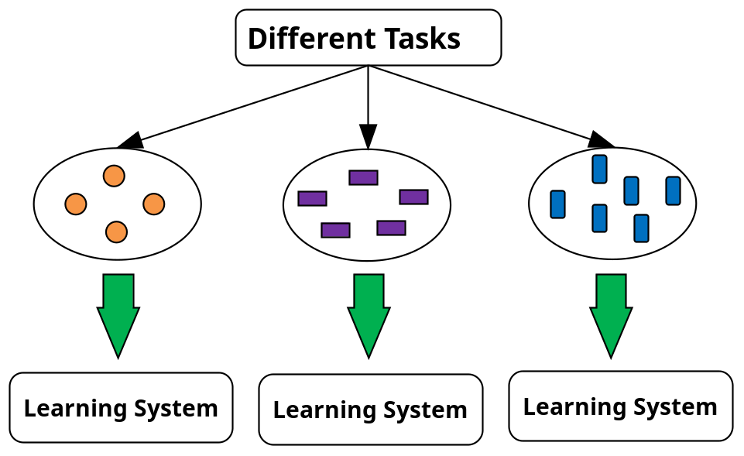
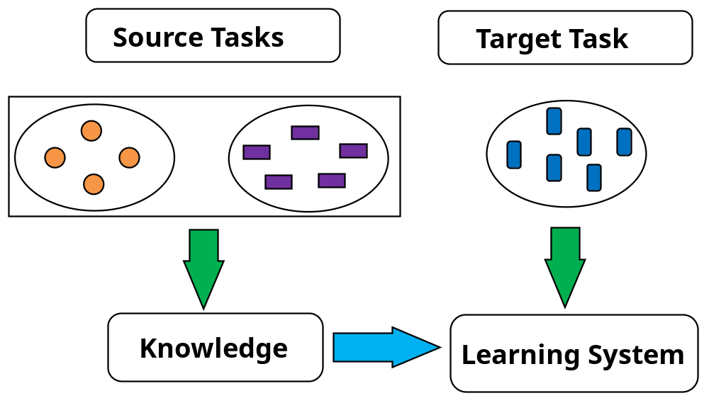
Transfer Learning: Conceptual Framework
Transfer learning: Extract knowledge from one or more source tasks and apply the knowledge to a target task
Traditional learning: Build a new classifier for each new task
Transfer learning: Build new classifier by applying existing knowledge learned from source tasks
Traditional Learning Framework
Transfer Learning Framework

Slide 68
Transfer Learning: Methods and Applications
Applications: Especially useful when data is outdated or distribution changes, e.g., Web document classification, e-mail spam filtering
Instance-based transfer learning: Reweight some of the data from source tasks and use it to learn the target task
TrAdaBoost (Transfer AdaBoost)
  Assume source and target data each described by the same set of attributes (features) & class labels, but rather diff. distributions
  Require only labeling a small amount of target data
  Use source data in training: When a source tuple is misclassified, reduce the weight of such tupels so that they will have less effect on the subsequent classifier
Research issues
  Negative transfer: When it performs worse than no transfer at all
  Heterogeneous transfer learning: Transfer knowledge from different feature space or multiple source domains
  Large-scale transfer learning

Slide 69
Chapter 9. Classification: Advanced Methods
Bayesian Belief Networks
Classification by Backpropagation
Support Vector Machines
Classification by Using Frequent Patterns
Lazy Learners (or Learning from Your Neighbors)
Other Classification Methods
Additional Topics Regarding Classification
Summary

Slide 70
Summary
Effective and advanced classification methods
  Bayesian belief network (probabilistic networks)
  Backpropagation (Neural networks)
  Support Vector Machine (SVM)
  Pattern-based classification
  Other classification methods: lazy learners (KNN, case-based reasoning), genetic algorithms, rough set and fuzzy set approaches
Additional Topics on Classification
  Multiclass classification
  Semi-supervised classification
  Active learning
  Transfer learning

Slide 71
References
Please see the references of Chapter 8

Slide 72
Surplus Slides

Slide 73
What Is Prediction?
(Numerical) prediction is similar to classification
  construct a model
  use model to predict continuous or ordered value for a given input
Prediction is different from classification
  Classification refers to predict categorical class label
  Prediction models continuous-valued functions
Major method for prediction: regression
  model the relationship between one or more independent or predictor variables and a dependent or response variable
Regression analysis
  Linear and multiple regression
  Non-linear regression
  Other regression methods: generalized linear model, Poisson regression, log-linear models, regression trees

Slide 74
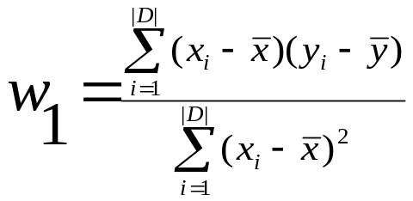
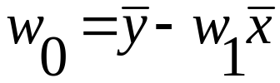
Linear Regression
Linear regression: involves a response variable y and a single predictor variable x
    y = w₀ + w₁ x
  where w₀ (y-intercept) and w₁ (slope) are regression coefficients
Method of least squares: estimates the best-fitting straight line
Multiple linear regression: involves more than one predictor variable
  Training data is of the form (X₁, y₁), (X₂, y₂),…, (X_{|D|}, y_{|D|})
  Ex. For 2-D data, we may have: y = w₀ + w₁ x₁+ w₂ x₂
  Solvable by extension of least square method or using SAS, S-Plus
  Many nonlinear functions can be transformed into the above

Slide 75
Nonlinear Regression
Some nonlinear models can be modeled by a polynomial function
A polynomial regression model can be transformed into linear regression model. For example,
    y = w₀ + w₁ x + w₂ x² + w₃ x³
  convertible to linear with new variables: x₂ = x², x₃= x³
    y = w₀ + w₁ x + w₂ x₂ + w₃ x₃
Other functions, such as power function, can also be transformed to linear model
Some models are intractable nonlinear (e.g., sum of exponential terms)
  possible to obtain least square estimates through extensive calculation on more complex formulae

Slide 76
Other Regression-Based Models
Generalized linear model:
  Foundation on which linear regression can be applied to modeling categorical response variables
  Variance of y is a function of the mean value of y, not a constant
  Logistic regression: models the prob. of some event occurring as a linear function of a set of predictor variables
  Poisson regression: models the data that exhibit a Poisson distribution
Log-linear models: (for categorical data)
  Approximate discrete multidimensional prob. distributions
  Also useful for data compression and smoothing
Regression trees and model trees
  Trees to predict continuous values rather than class labels

Slide 77
Regression Trees and Model Trees
Regression tree: proposed in CART system (Breiman et al. 1984)
  CART: Classification And Regression Trees
  Each leaf stores a continuous-valued prediction
  It is the average value of the predicted attribute for the training tuples that reach the leaf
Model tree: proposed by Quinlan (1992)
  Each leaf holds a regression model—a multivariate linear equation for the predicted attribute
  A more general case than regression tree
Regression and model trees tend to be more accurate than linear regression when the data are not represented well by a simple linear model

Slide 78
Predictive Modeling in Multidimensional Databases
Predictive modeling: Predict data values or construct generalized linear models based on the database data
One can only predict value ranges or category distributions
Method outline:
  Minimal generalization
  Attribute relevance analysis
  Generalized linear model construction
  Prediction
Determine the major factors which influence the prediction
  Data relevance analysis: uncertainty measurement, entropy analysis, expert judgement, etc.
Multi-level prediction: drill-down and roll-up analysis

Slide 79
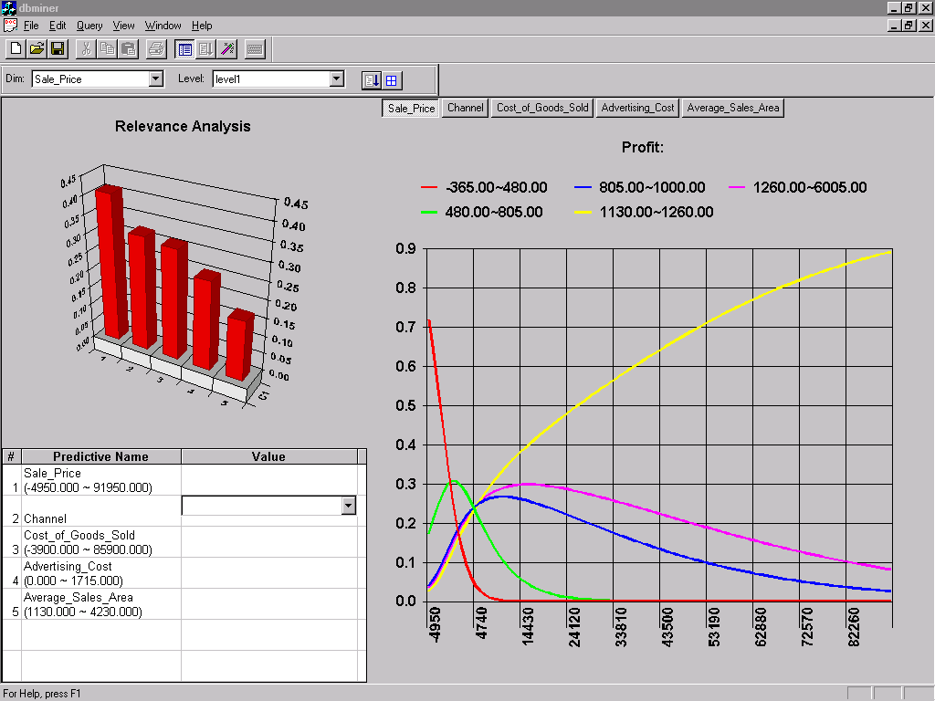
Prediction: Numerical Data

Slide 80
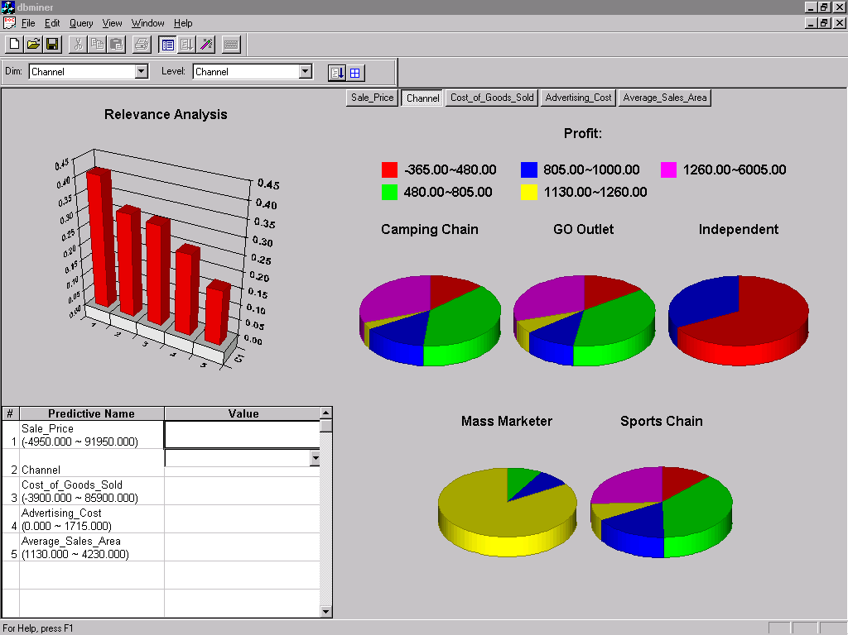
Prediction: Categorical Data

Slide 81
SVM—Introductory Literature
“Statistical Learning Theory” by Vapnik: extremely hard to understand, containing many errors too.
C. J. C. Burges. A Tutorial on Support Vector Machines for Pattern Recognition. Knowledge Discovery and Data Mining, 2(2), 1998.
  Better than the Vapnik’s book, but still written too hard for introduction, and the examples are so not-intuitive
The book “An Introduction to Support Vector Machines” by N. Cristianini and J. Shawe-Taylor
  Also written hard for introduction, but the explanation about the mercer’s theorem is better than above literatures
The neural network book by Haykins
  Contains one nice chapter of SVM introduction

Slide 82
Notes about SVM—
Introductory Literature
“Statistical Learning Theory” by Vapnik: difficult to understand, containing many errors.
C. J. C. Burges. A Tutorial on Support Vector Machines for Pattern Recognition. Knowledge Discovery and Data Mining, 2(2), 1998.
  Easier than Vapnik’s book, but still not introductory level; the examples are not so intuitive
The book An Introduction to Support Vector Machines by Cristianini and Shawe-Taylor
  Not introductory level, but the explanation about Mercer’s Theorem is better than above literatures
Neural Networks and Learning Machines by Haykin
  Contains a nice chapter on SVM introduction

Slide 83
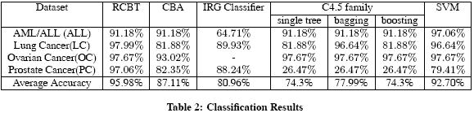
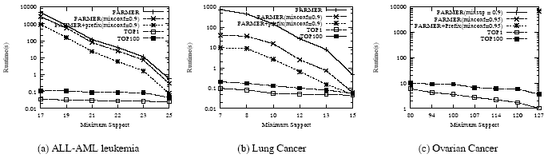
Associative Classification Can Achieve High Accuracy and Efficiency (Cong et al. SIGMOD05)

Slide 84
A Closer Look at CMAR
CMAR (Classification based on Multiple Association Rules: Li, Han, Pei, ICDM’01)
Efficiency: Uses an enhanced FP-tree that maintains the distribution of class labels among tuples satisfying each frequent itemset
Rule pruning whenever a rule is inserted into the tree
  Given two rules, R₁ and R₂, if the antecedent of R₁ is more general than that of R₂ and conf(R₁) ≥ conf(R₂), then prune R₂
  Prunes rules for which the rule antecedent and class are not positively correlated, based on a χ² test of statistical significance
Classification based on generated/pruned rules
  If only one rule satisfies tuple X, assign the class label of the rule
  If a rule set S satisfies X, CMAR
    divides S into groups according to class labels
    uses a weighted χ² measure to find the strongest group of rules, based on the statistical correlation of rules within a group
    assigns X the class label of the strongest group

Slide 85
Perceptron & Winnow
Vector: x, w
Scalar: x, y, w
Input: {(x₁, y₁), …}
Output: classification function f(x)
f(x_{i}) > 0 for y_{i} = +1
f(x_{i}) < 0 for y_{i} = -1
f(x) => wx + b = 0
or w₁x₁+w₂x₂+b = 0
x₂
Perceptron: update W additively
Winnow: update W multiplicatively
x₁
Notes:
MK: Do we want to keep this slide? It is not in the text and may confuse the students.

